Slide 1
Lecture 19: Generative Models, Part 1
Lecture 19 - 1

Slide 2
Reminder: Assignment 5
A5 released; due Monday November 16, 11:59pm EST
A5 covers object detection:
Single-stage detectors
Two-stage detectors
Lecture 19 - 2

Slide 3
Midterm Grades Released
Midterm grades released on Gradescope
Mean score: 77.5 (std 12.3)
If you think there was an error in grading your exam, submit a regrade request via Gradescope by Tuesday, November 17
After all regrades are finalized, we’ll copy the final exam grades over to Canvas
Lecture 19 - 3

Slide 4
Last Time: Videos
Many video models:
Single-frame CNN (Try this first!) Late fusion
Early fusion
3D CNN / C3D
Two-stream networks CNN + RNN
Convolutional RNN
Spatio-temporal self-attention SlowFast networks (current SoTA)
Lecture 19 - 4

Slide 5
Today: Generative Models, Part 1
Lecture 19 - 5

Slide 6
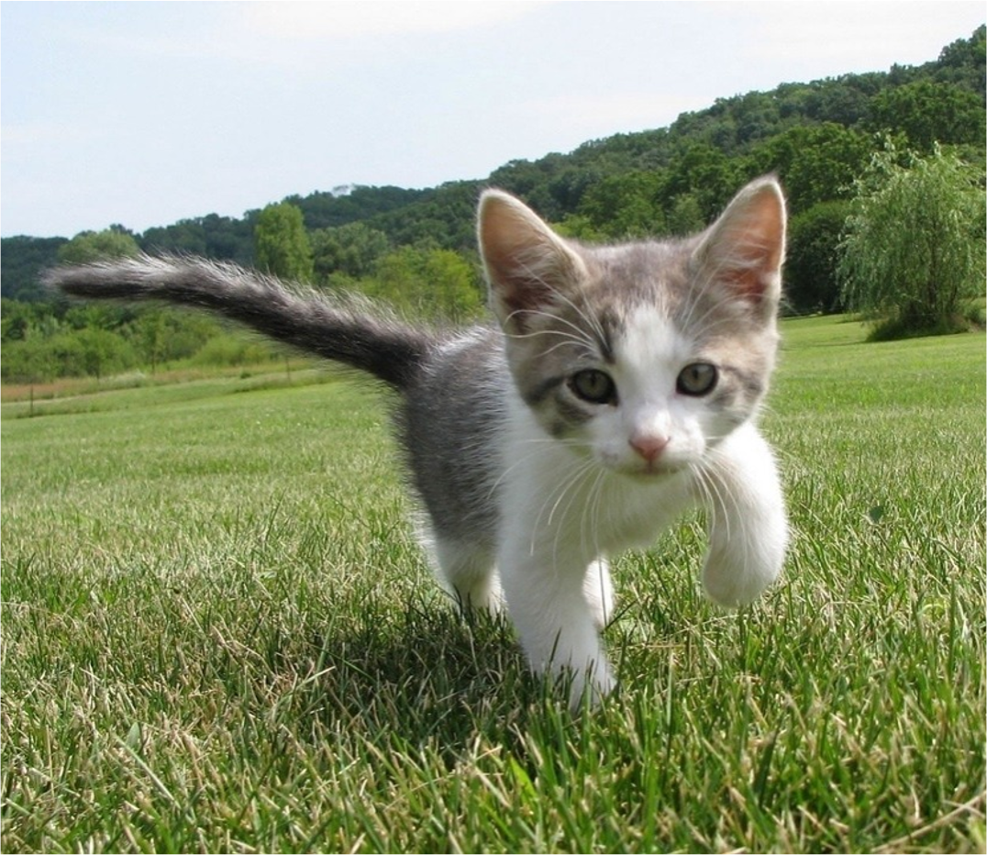
Supervised vs Unsupervised Learning
Supervised Learning
Classification
Data: (x, y)
x is data, y is label
Goal: Learn a function to map x -> y
Examples: Classification, regression, object detection, semantic segmentation, image captioning, etc.
Cat
This image is CC0 public domain
Lecture 19 - 6

Slide 7
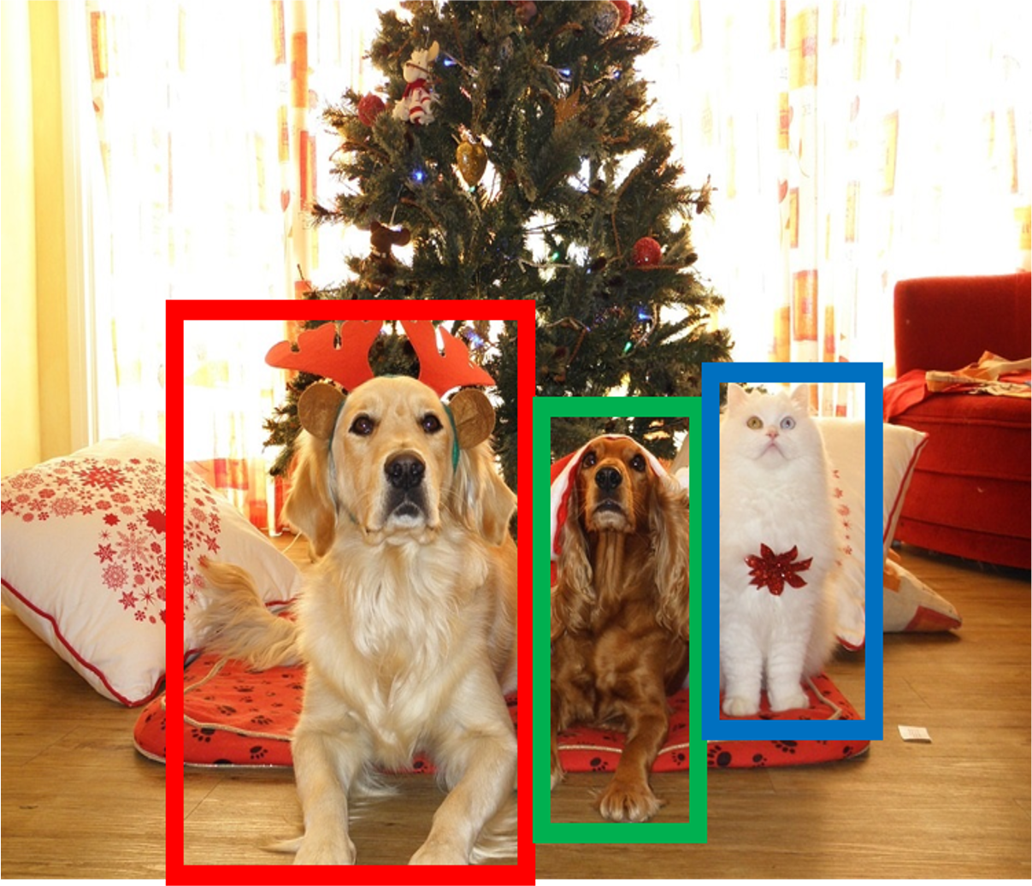
Supervised vs Unsupervised Learning
Supervised Learning
Object Detection
Data: (x, y)
x is data, y is label
Goal: Learn a function to map x -> y
Examples: Classification, regression, object detection, semantic segmentation, image captioning, etc.
DOG, DOG, CAT
This image is CC0 public domain
Lecture 19 - 7

Slide 8
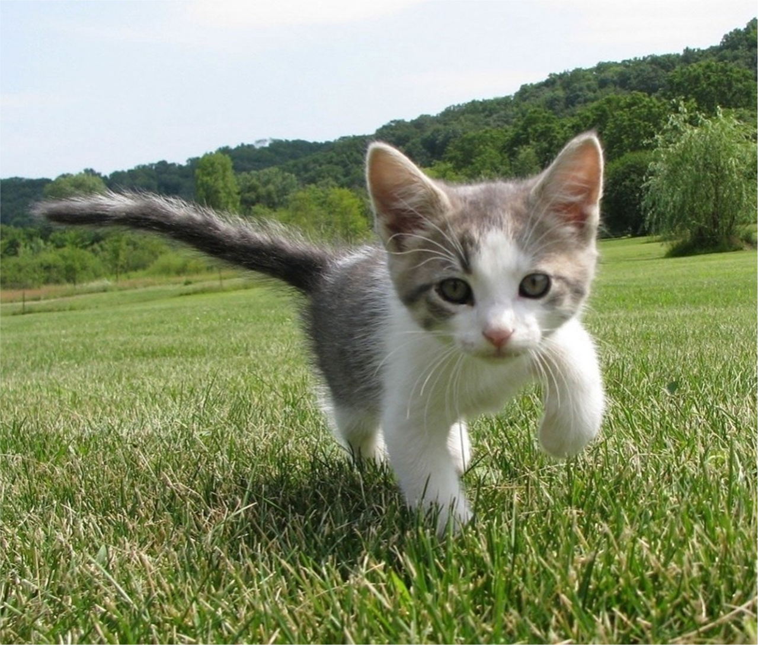
Supervised vs Unsupervised Learning
Supervised Learning
Semantic Segmentation
Data: (x, y)
x is data, y is label
Goal: Learn a function to map x -> y
Examples: Classification, regression, object detection, semantic segmentation, image captioning, etc.
GRASS, CAT, TREE, SKY

Slide 9
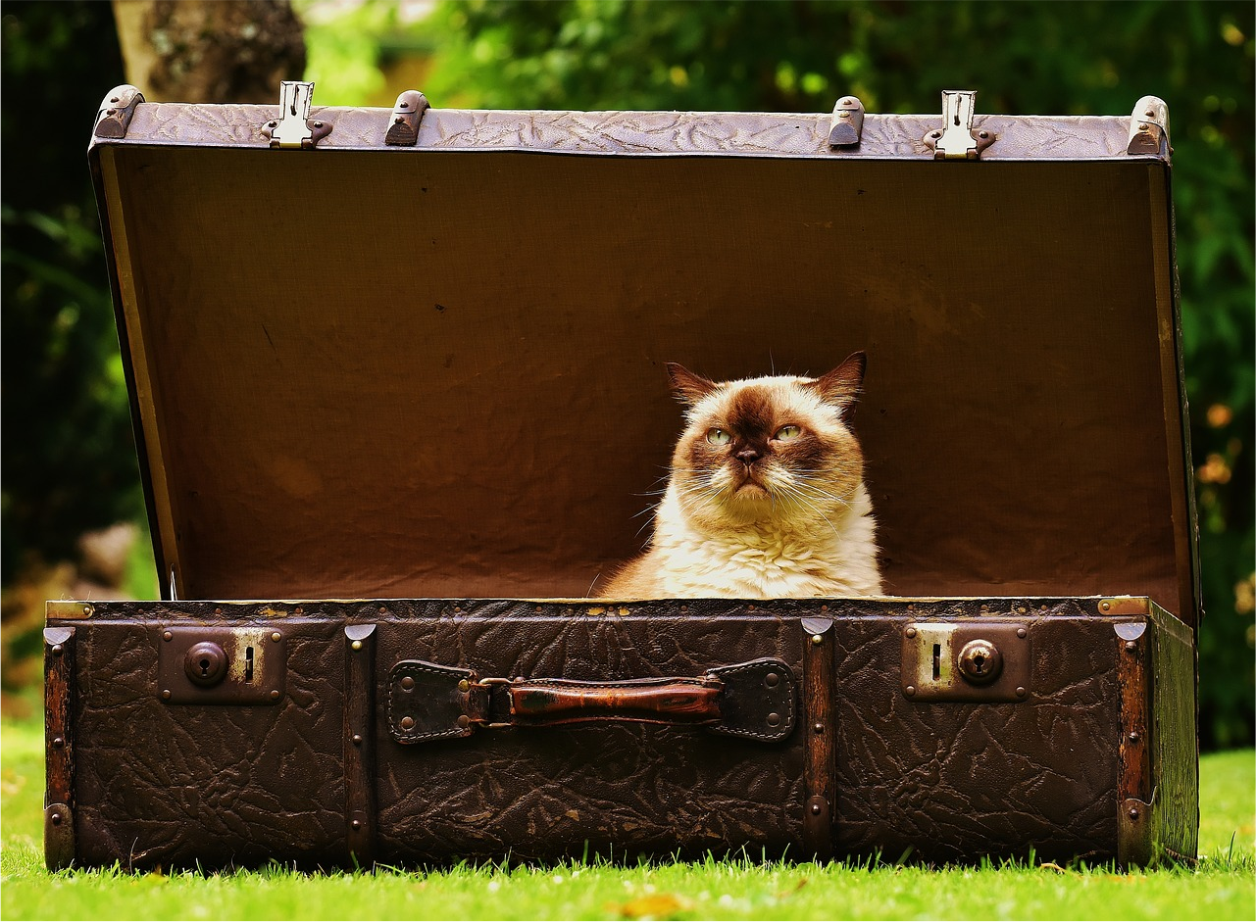
Supervised vs Unsupervised Learning
Supervised Learning
Image captioning
Data: (x, y)
x is data, y is label
Goal: Learn a function to map x -> y
A cat sitting on a suitcase on the floor
Examples: Classification, regression, object detection, semantic segmentation, image captioning, etc.
Caption generated using neuraltalk2 Image is CC0 Public domain.

Slide 10
Supervised vs Unsupervised Learning
Supervised Learning Unsupervised Learning
Data: (x, y)
x is data, y is label
Data: x
Just data, no labels!
Goal: Learn a function to map x -> y
Goal: Learn some underlying hidden structure of the data
Examples: Classification, regression, object detection, semantic segmentation, image captioning, etc.
Examples: Clustering, dimensionality reduction, feature learning, density estimation, etc.

Slide 11
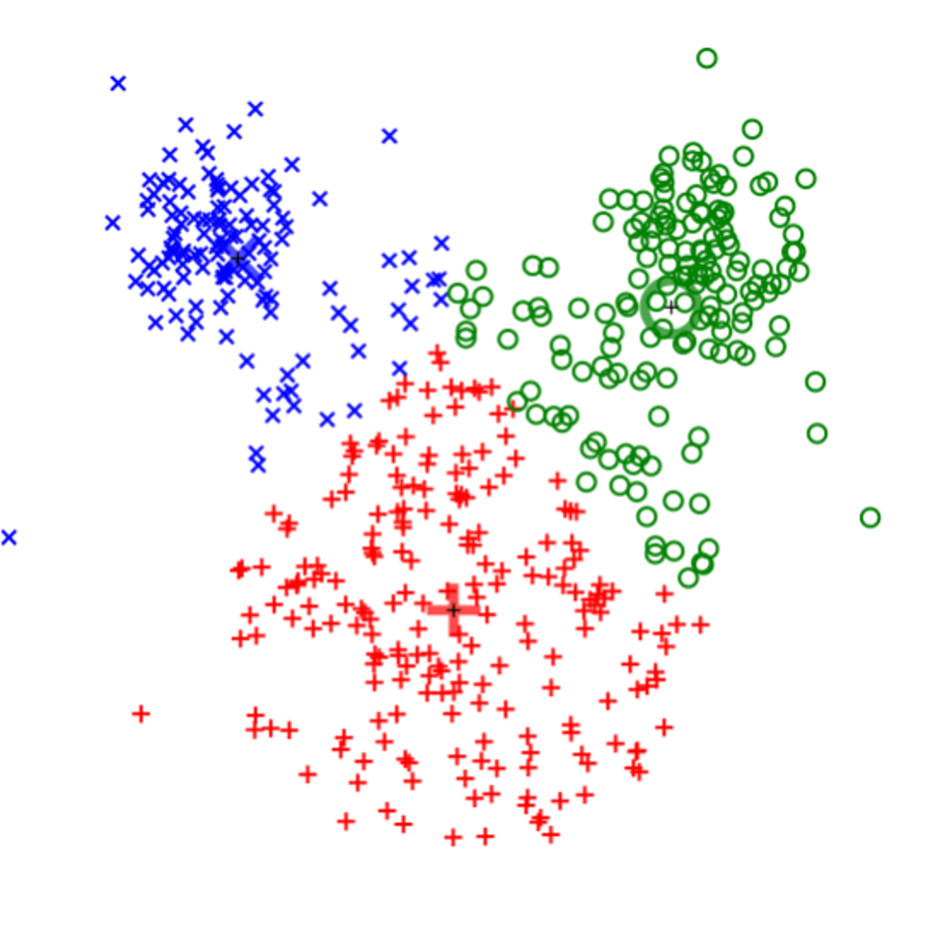
Supervised vs Unsupervised Learning
Clustering (e.g. K-Means)
Unsupervised Learning
Data: x
Just data, no labels!
Goal: Learn some underlying hidden structure of the data
Examples: Clustering, dimensionality reduction, feature learning, density estimation, etc.
This image is CC0 public domain

Slide 12
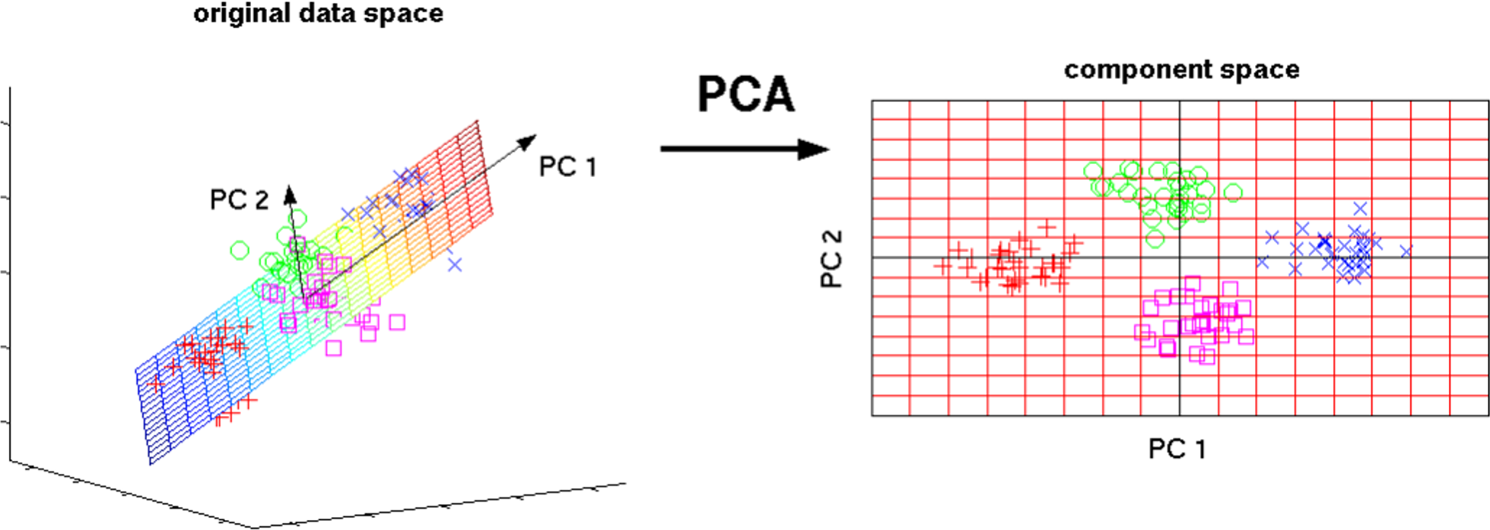
Supervised vs Unsupervised Learning
Unsupervised Learning
Dimensionality Reduction
(e.g. Principal Components Analysis)
Data: x
Just data, no labels!
Goal: Learn some underlying hidden structure of the data
3D
2D
Examples: Clustering, dimensionality reduction, feature learning, density estimation, etc.
This image from Matthias Scholz is CC0 public domain
Lecture 19 - 12

Slide 13
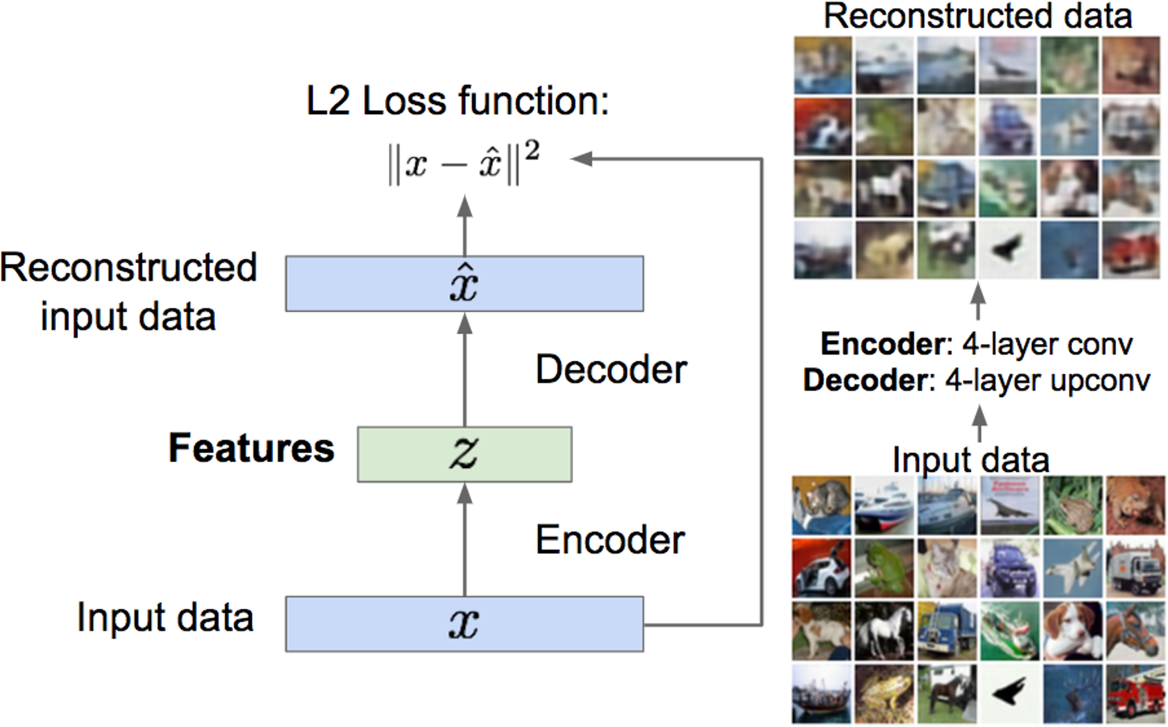
Supervised vs Unsupervised Learning
Feature Learning (e.g. autoencoders)
Unsupervised Learning
Data: x
Just data, no labels!
Goal: Learn some underlying hidden structure of the data
Examples: Clustering, dimensionality reduction, feature learning, density estimation, etc.

Slide 14
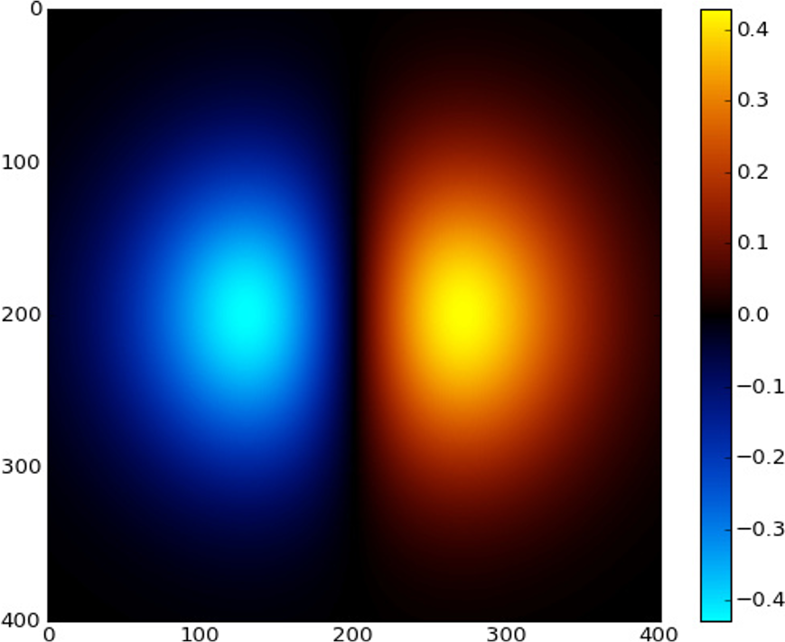
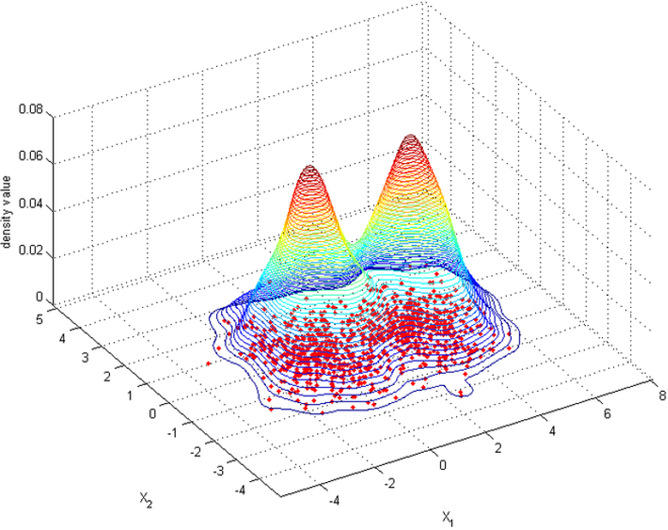
Supervised vs Unsupervised Learning
Unsupervised Learning
Density Estimation
Data: x
Just data, no labels!
Goal: Learn some underlying hidden structure of the data
Examples: Clustering, dimensionality reduction, feature learning, density estimation, etc.
Images left and right are CC0 public domain

Slide 15
Supervised vs Unsupervised Learning
Supervised Learning Unsupervised Learning
Data: (x, y)
x is data, y is label
Data: x
Just data, no labels!
Goal: Learn a function to map x -> y
Goal: Learn some underlying hidden structure of the data
Examples: Classification, regression, object detection, semantic segmentation, image captioning, etc.
Examples: Clustering, dimensionality reduction, feature learning, density estimation, etc.

Slide 16

Discriminative vs Generative Models
Discriminative Model: Learn a probability distribution p(y|x)
Data: x
Generative Model: Learn a probability distribution p(x)
Label: y
Cat
Conditional Generative Model: Learn p(x|y)

Slide 17
Discriminative vs Generative Models
Probability Recap:
Density Function
p(x) assigns a positive number to each possible x; higher numbers mean x is more likely
Density functions are
normalized:
Discriminative Model: Learn a probability distribution p(y|x)
Data: x
Generative Model: Learn a probability distribution p(x)
! 𝑝 𝑥 𝑑𝑥 = 1
!
Different values of x
compete for density
Label: y
Cat
Conditional Generative Model: Learn p(x|y)

Slide 18
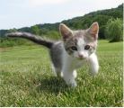
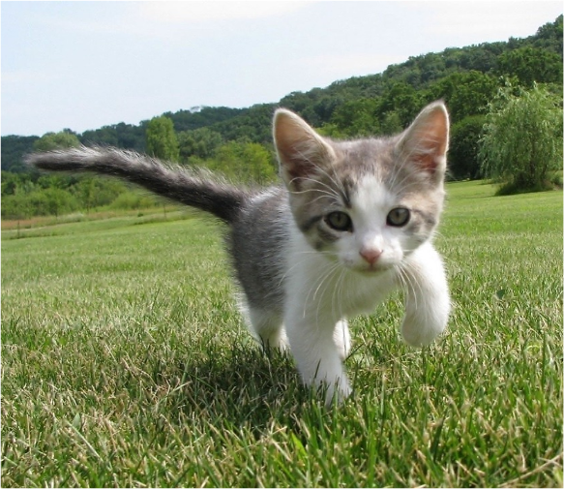
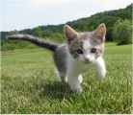
Discriminative vs Generative Models
P(cat|. )
P(dog|. )
Discriminative Model: Learn a probability distribution p(y|x)
Data: x
Generative Model: Learn a probability distribution p(x)
Conditional Generative Model: Learn p(x|y)
Density functions are normalized:
Density Function
p(x) assigns a positive number to each possible x; higher numbers mean x is more likely
! 𝑝 𝑥 𝑑𝑥 = 1
!
Different values of x
compete for density

Slide 19
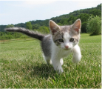
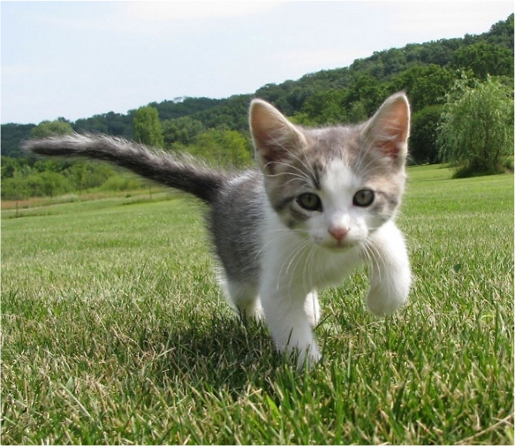
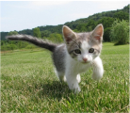
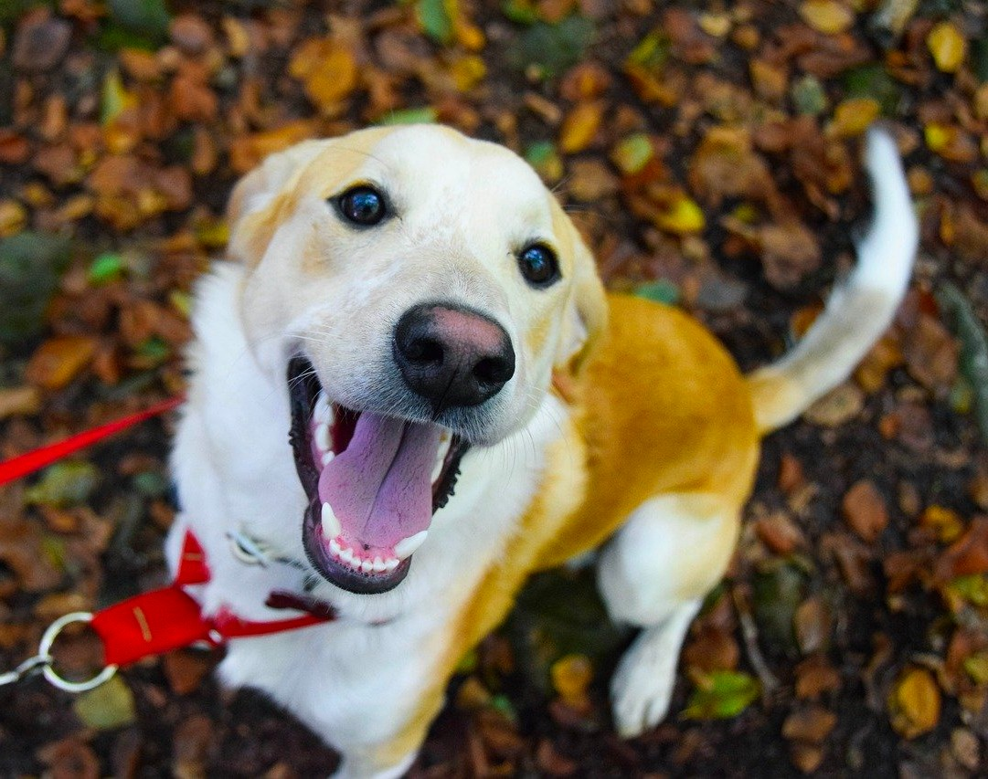
Discriminative vs Generative Models
P(cat|. )
Discriminative Model: Learn a probability distribution p(y|x)
P(dog|. )
Generative Model: Learn a probability distribution p(x)
P(dog| )
P(cat| )
Discriminative model: the possible labels for each input ”compete” for probability mass.
But no competition between images
Conditional Generative Model: Learn p(x|y)
Dog image is CC0 Public Domain

Slide 20
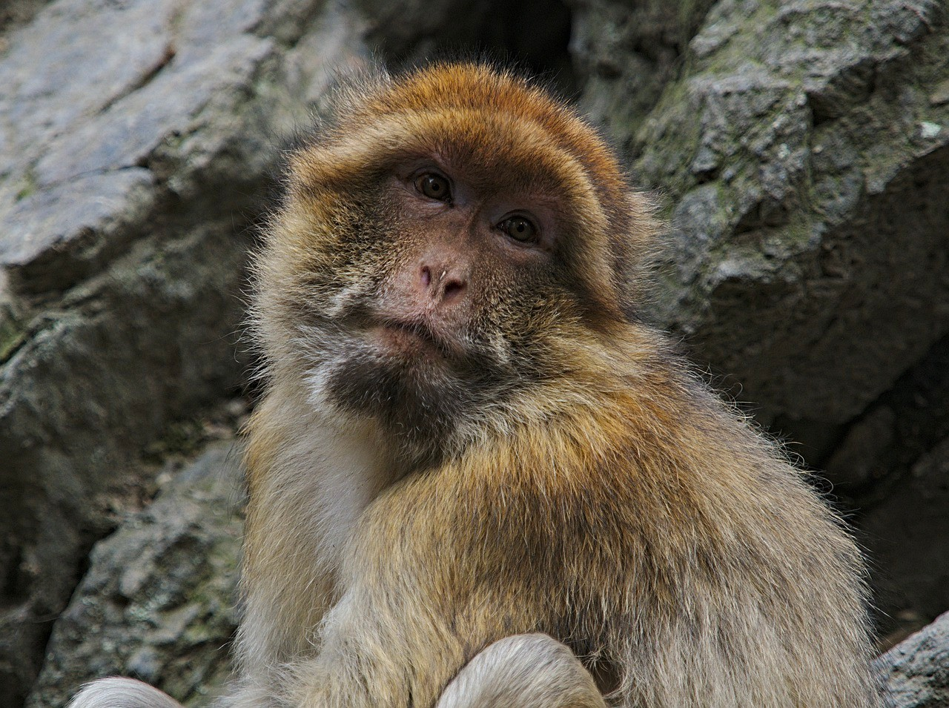
Discriminative vs Generative Models
Discriminative Model: Learn a probability distribution p(y|x)
P(cat| )
P(dog| )
Generative Model: Learn a probability distribution p(x)
P(dog| )
P(cat| )
Discriminative model: No way for the model to handle unreasonable inputs; it must give label distributions for all images
Conditional Generative Model: Learn p(x|y)
Monkey image is CC0 Public Domain

Slide 21
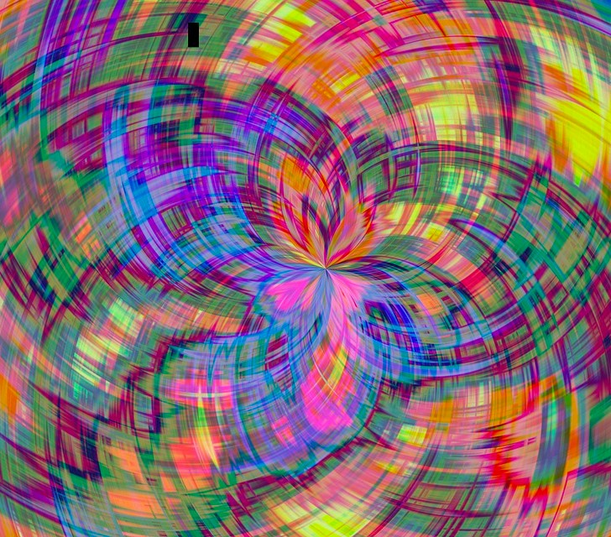
Discriminative vs Generative Models
Discriminative Model: Learn a probability distribution p(y|x)
P(cat| )
P(dog| )
Generative Model: Learn a probability distribution p(x)
P(dog| )
P(cat| )
Conditional Generative Model: Learn p(x|y)
Discriminative model: No way for the model to handle unreasonable inputs; it must give
label distributions for all images
Monkey image is CC0 Public Domain
Abstract image is free to use under the Pixabay license

Slide 22
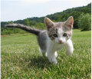
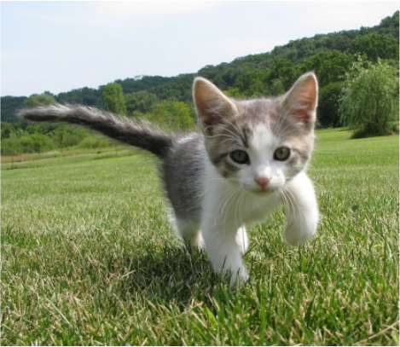
Discriminative vs Generative Models
P( )
Cat image is CC0 public domain Dog image is CC0 Public Domain
Monkey image is CC0 Public Domain
Abstract image is free to use under the Pixabay license
Discriminative Model: Learn a probability distribution p(y|x)
P( )
P( )
P( )
Generative Model: Learn a probability distribution p(x)
…
Generative model: All possible images compete with each other for probability mass
Conditional Generative Model: Learn p(x|y)

Slide 23
Discriminative vs Generative Models
P( )
Cat image is CC0 public domain Dog image is CC0 Public Domain
Monkey image is CC0 Public Domain
Abstract image is free to use under the Pixabay license
Discriminative Model: Learn a probability distribution p(y|x)
P( )
P( )
P( )
Generative Model: Learn a probability distribution p(x)
…
Generative model: All possible images compete with each other for probability mass
Conditional Generative Model: Learn p(x|y)
Requires deep image understanding! Is a dog more likely to sit or stand? How about 3-legged dog vs 3-armed monkey?

Slide 24
Discriminative vs Generative Models
P( )
Cat image is CC0 public domain Dog image is CC0 Public Domain
Monkey image is CC0 Public Domain
Abstract image is free to use under the Pixabay license
Discriminative Model: Learn a probability distribution p(y|x)
P( )
P( )
P( )
Generative Model: Learn a probability distribution p(x)
…
Generative model: All possible images compete with each other for probability mass
Conditional Generative Model: Learn p(x|y)
Model can “reject” unreasonable inputs by assigning them small values
Lecture 19 - 24

Slide 25

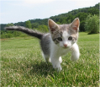

Discriminative vs Generative Models
P( |cat)
Cat image is CC0 public domain Dog image is CC0 Public Domain
Monkey image is CC0 Public Domain
Abstract image is free to use under the Pixabay license
Discriminative Model: Learn a probability distribution p(y|x)
P( |cat)
P( |dog)
P( |cat)
P( |cat)
P( |dog)
P( |dog)
P( |dog)
Generative Model: Learn a probability distribution p(x)
…
Conditional Generative Model: Learn p(x|y)
Conditional Generative Model: Each possible label induces a competition among all images

Slide 26
Cat image is CC0 public domain Dog image is CC0 Public Domain
Monkey image is CC0 Public Domain
Abstract image is free to use under the Pixabay license
Discriminative vs Generative Models
Recall Bayes’ Rule:
Discriminative Model: Learn a probability distribution p(y|x)
𝑃 𝑥
𝑦) = ^{𝑃 𝑦}
^{𝑥)} 𝑃(𝑥)
Generative Model: Learn a probability distribution p(x)
𝑃 𝑦
Conditional Generative Model: Learn p(x|y)

Slide 27
Cat image is CC0 public domain Dog image is CC0 Public Domain
Monkey image is CC0 Public Domain
Abstract image is free to use under the Pixabay license
Discriminative vs Generative Models
Recall Bayes’ Rule:
Discriminative Model: Learn a probability distribution p(y|x)
Discriminative Model
(Unconditional) Generative Model
𝑃 𝑦 𝑥)
𝑃 𝑥 𝑦)
=
𝑃(𝑥)
Generative Model: Learn a probability distribution p(x)
𝑃 𝑦
Conditional Generative Model
Prior over labels
Conditional Generative Model: Learn p(x|y)
We can build a conditional generative model from other components!

Slide 28
What can we do with a discriminative model?
Discriminative Model: Learn a probability distribution p(y|x)
Generative Model: Learn a probability distribution p(x)
Conditional Generative Model: Learn p(x|y)
Assign labels to data
Feature learning (with labels)

Slide 29
What can we do with a generative model?
Discriminative Model: Learn a probability distribution p(y|x)
Generative Model: Learn a probability distribution p(x)
Conditional Generative Model: Learn p(x|y)
Assign labels to data
Feature learning (with labels)
Detect outliers
Feature learning (without labels) Sample to generate new data

Slide 30
What can we do with a generative model?
Discriminative Model: Learn a probability distribution p(y|x)
Generative Model: Learn a probability distribution p(x)
Conditional Generative Model: Learn p(x|y)
Assign labels to data
Feature learning (with labels)
Detect outliers
Feature learning (without labels) Sample to generate new data
Assign labels, while rejecting outliers! Generate new data conditioned on input labels

Slide 31
Taxonomy of Generative Models
Generative models
Figure adapted from Ian Goodfellow, Tutorial on Generative Adversarial Networks, 2017.

Slide 32
Taxonomy of Generative Models
Model does not explicitly compute p(x), but can sample from p(x)
Model can compute p(x)
Generative models
Explicit density
Implicit density
Figure adapted from Ian Goodfellow, Tutorial on Generative Adversarial Networks, 2017.

Slide 33
Taxonomy of Generative Models
Model does not explicitly compute p(x), but can sample from p(x)
Model can compute p(x)
Generative models
Explicit density
Implicit density
Can compute approximation to p(x)
Tractable density
Approximate density
Can compute p(x)
Autoregressive
NADE / MADE
NICE / RealNVP
Glow
Ffjord
Figure adapted from Ian Goodfellow, Tutorial on Generative Adversarial Networks, 2017.

Slide 34
Taxonomy of Generative Models
Model does not explicitly compute p(x), but can sample from p(x)
Model can compute p(x)
Generative models
Explicit density
Implicit density
Can compute approximation to p(x)
Tractable density
Approximate density
Can compute p(x)
Autoregressive
NADE / MADE
NICE / RealNVP
Variational
Markov Chain
-
-
Glow Ffjord
Variational Autoencoder
Boltzmann Machine
Figure adapted from Ian Goodfellow, Tutorial on Generative Adversarial Networks, 2017.

Slide 35
Taxonomy of Generative Models
Model does not explicitly compute p(x), but can sample from p(x)
Model can compute p(x)
Generative models
Explicit density
Implicit density
Can compute approximation to p(x)
Tractable density
Approximate density
Markov Chain
Direct
Can compute p(x)
GSN
Generative Adversarial Networks (GANs)
Autoregressive
NADE / MADE
NICE / RealNVP
Glow
Ffjord
Variational
Markov Chain
Variational Autoencoder
Boltzmann Machine
Figure adapted from Ian Goodfellow, Tutorial on Generative Adversarial Networks, 2017.

Slide 36
Taxonomy of Generative Models
Model does not explicitly compute p(x), but can sample from p(x)
Model can compute p(x)
Generative models
Explicit density
Implicit density
Can compute approximation to p(x)
Tractable density
Approximate density
Markov Chain
Direct
Can compute p(x)
GSN
Generative Adversarial Networks (GANs)
Autoregressive
-
NADE / MADE
NICE / RealNVP
Glow
Ffjord
Variational
Markov Chain
We will talk about these
Variational Autoencoder
Boltzmann Machine
Figure adapted from Ian Goodfellow, Tutorial on Generative Adversarial Networks, 2017.

Slide 37
Autoregressive models

Slide 38
Explicit Density Estimation
Goal: Write down an explicit function for 𝑝 𝑥
= 𝑓(𝑥, 𝑊)

Slide 39
Explicit Density Estimation
Goal: Write down an explicit function for 𝑝 𝑥 = 𝑓(𝑥, 𝑊)
Given dataset 𝑥^{(#)}, 𝑥^{(%)}, … 𝑥 & , train the model by solving:
Maximize probability of training data
𝑊∗ = arg max 2 𝑝(𝑥 ⁾ )
(
(Maximum likelihood estimation)
)

Slide 40
Explicit Density Estimation
Goal: Write down an explicit function for 𝑝 𝑥 = 𝑓(𝑥, 𝑊)
Given dataset 𝑥^{(#)}, 𝑥^{(%)}, … 𝑥 & , train the model by solving:
Maximize probability of training data
𝑊∗ = arg max 2 𝑝(𝑥 ⁾ )
(
(Maximum likelihood estimation)
)
= arg max ∑₎ log 𝑝(𝑥 ⁾ )
Log trick to exchange product for sum
*

Slide 41
Explicit Density Estimation
Goal: Write down an explicit function for 𝑝 𝑥 = 𝑓(𝑥, 𝑊)
Given dataset 𝑥^{(#)}, 𝑥^{(%)}, … 𝑥 & , train the model by solving:
Maximize probability of training data
𝑊∗ = arg max 2 𝑝(𝑥 ⁾ )
(
(Maximum likelihood estimation)
)
= arg max ∑₎ log 𝑝(𝑥 ⁾ )
Log trick to exchange product for sum
*
= arg max ∑₎ log 𝑓(𝑥 ⁾ , 𝑊)
This will be our loss function! Train with gradient descent
*

Slide 42
Explicit Density: Autoregressive Models
Goal: Write down an explicit function for 𝑝 𝑥 = 𝑓(𝑥, 𝑊)
Assume x consists of multiple subparts:
𝑥 = 𝑥!, 𝑥", 𝑥#, … , 𝑥$

Slide 43
Explicit Density: Autoregressive Models
Goal: Write down an explicit function for 𝑝 𝑥 = 𝑓(𝑥, 𝑊)
Assume x consists of multiple subparts:
Break down probability using the chain rule:
𝑥 = 𝑥!, 𝑥", 𝑥#, … , 𝑥$
𝑝 𝑥
= 𝑝 𝑥!, 𝑥", 𝑥#, … , 𝑥$
= 𝑝 𝑥! 𝑝 𝑥" 𝑥!)𝑝 𝑥#
𝑥!, 𝑥") …

Slide 44
Explicit Density: Autoregressive Models
Goal: Write down an explicit function for 𝑝 𝑥 = 𝑓(𝑥, 𝑊)
Assume x consists of multiple subparts:
Break down probability using the chain rule:
𝑥 = 𝑥!, 𝑥", 𝑥#, … , 𝑥$
𝑝 𝑥
= 𝑝 𝑥!, 𝑥", 𝑥#, … , 𝑥$
= 𝑝 𝑥! 𝑝 𝑥" 𝑥!)𝑝 𝑥# 𝑥!, 𝑥") …
_{= ∏}$
𝑝 𝑥% 𝑥!, … , 𝑥%'!)
Probability of the next subpart given all the previous subparts
%&!

Slide 45
Explicit Density: Autoregressive Models
Goal: Write down an explicit function for 𝑝 𝑥 = 𝑓(𝑥, 𝑊)
Assume x consists of multiple subparts:
Break down probability using the chain rule:
𝑥 = 𝑥!, 𝑥", 𝑥#, … , 𝑥$
𝑝 𝑥 = 𝑝 𝑥!, 𝑥", 𝑥#, … , 𝑥$
= 𝑝 𝑥! 𝑝 𝑥" 𝑥!)𝑝 𝑥# 𝑥!, 𝑥") …
𝑝 𝑥% 𝑥!, … , 𝑥%'!)
Probability of the next subpart given all the previous subparts
p(x₁) p(x₂) p(x₃) p(x₄)
We’ve already = ∏$
%&!
seen this! Language modeling with an RNN!
h₁ h₂ h₃ h₄
x₀ x₁ x₂ x₃

Slide 46

PixelRNN
Generate image pixels one at a time, starting at the upper left corner
Compute a hidden state for each pixel that depends on hidden states and RGB values from the left and from above (LSTM recurrence)
^{ℎ}!,# ^{= 𝑓(ℎ}!$%,#^{, ℎ}!,#$%^{, 𝑊)}
At each pixel, predict red, then blue, then green: softmax over [0, 1, …, 255]
Van den Oord et al, “Pixel Recurrent Neural Networks”, ICML 2016
November 11, 2020

Slide 47

PixelRNN
Generate image pixels one at a time, starting at the upper left corner
Compute a hidden state for each pixel that depends on hidden states and RGB values from the left and from above (LSTM recurrence)
^{ℎ}!,# ^{= 𝑓(ℎ}!$%,#^{, ℎ}!,#$%^{, 𝑊)}
At each pixel, predict red, then blue, then green: softmax over [0, 1, …, 255]
Van den Oord et al, “Pixel Recurrent Neural Networks”, ICML 2016
November 11, 2020

Slide 48
PixelRNN
Generate image pixels one at a time, starting at the upper left corner
Compute a hidden state for each pixel that depends on hidden states and RGB values from the left and from above (LSTM recurrence)
^{ℎ}!,# ^{= 𝑓(ℎ}!$%,#^{, ℎ}!,#$%^{, 𝑊)}
At each pixel, predict red, then blue, then green: softmax over [0, 1, …, 255]
Van den Oord et al, “Pixel Recurrent Neural Networks”, ICML 2016
November 11, 2020

Slide 49
PixelRNN
Generate image pixels one at a time, starting at the upper left corner
Compute a hidden state for each pixel that depends on hidden states and RGB values from the left and from above (LSTM recurrence)
^{ℎ}!,# ^{= 𝑓(ℎ}!$%,#^{, ℎ}!,#$%^{, 𝑊)}
At each pixel, predict red, then blue, then green: softmax over [0, 1, …, 255]
Van den Oord et al, “Pixel Recurrent Neural Networks”, ICML 2016
November 11, 2020

Slide 50
PixelRNN
Generate image pixels one at a time, starting at the upper left corner
Compute a hidden state for each pixel that depends on hidden states and RGB values from the left and from above (LSTM recurrence)
^{ℎ}!,# ^{= 𝑓(ℎ}!$%,#^{, ℎ}!,#$%^{, 𝑊)}
At each pixel, predict red, then blue, then green: softmax over [0, 1, …, 255]
Van den Oord et al, “Pixel Recurrent Neural Networks”, ICML 2016
November 11, 2020

Slide 51
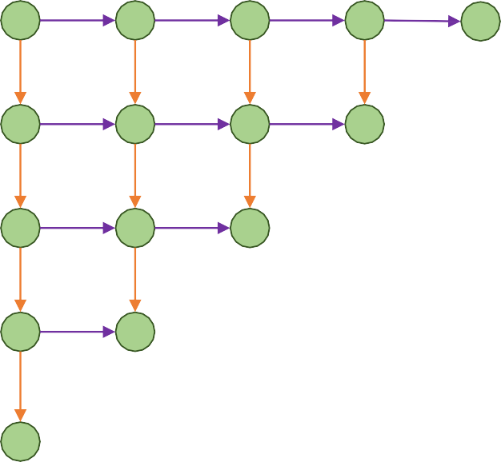
PixelRNN
Generate image pixels one at a time, starting at the upper left corner
Compute a hidden state for each pixel that depends on hidden states and RGB values from the left and from above (LSTM recurrence)
^{ℎ}!,# ^{= 𝑓(ℎ}!$%,#^{, ℎ}!,#$%^{, 𝑊)}
At each pixel, predict red, then blue, then green: softmax over [0, 1, …, 255]
Van den Oord et al, “Pixel Recurrent Neural Networks”, ICML 2016
November 11, 2020

Slide 52
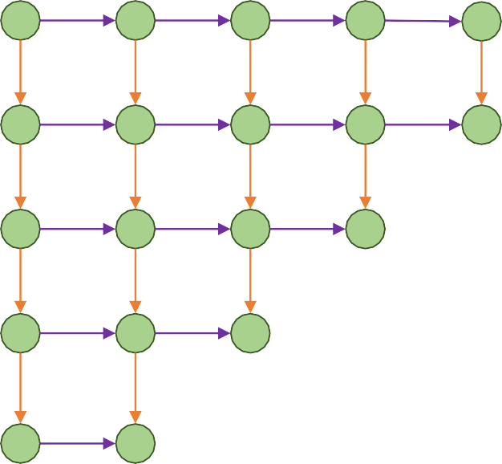
PixelRNN
Generate image pixels one at a time, starting at the upper left corner
Compute a hidden state for each pixel that depends on hidden states and RGB values from the left and from above (LSTM recurrence)
^{ℎ}!,# ^{= 𝑓(ℎ}!$%,#^{, ℎ}!,#$%^{, 𝑊)}
At each pixel, predict red, then blue, then green: softmax over [0, 1, …, 255]
Van den Oord et al, “Pixel Recurrent Neural Networks”, ICML 2016
November 11, 2020

Slide 53
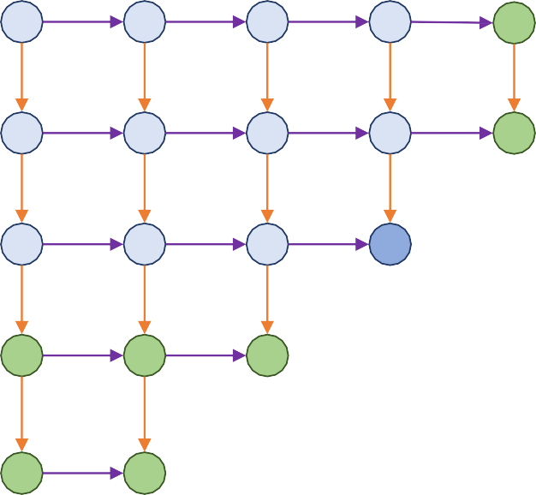
PixelRNN
Generate image pixels one at a time, starting at the upper left corner
Compute a hidden state for each pixel that depends on hidden states and RGB values from the left and from above (LSTM recurrence)
^{ℎ}!,# ^{= 𝑓(ℎ}!$%,#^{, ℎ}!,#$%^{, 𝑊)}
At each pixel, predict red, then blue, then green: softmax over [0, 1, …, 255]
Each pixel depends implicity on all pixels above and to the left:
Van den Oord et al, “Pixel Recurrent Neural Networks”, ICML 2016
November 11, 2020

Slide 54
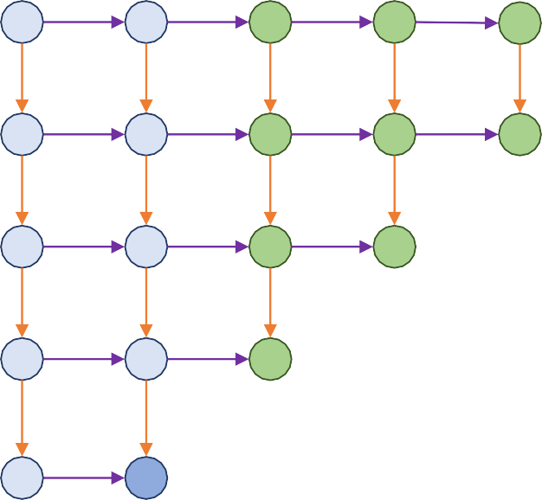
PixelRNN
Generate image pixels one at a time, starting at the upper left corner
Compute a hidden state for each pixel that depends on hidden states and RGB values from the left and from above (LSTM recurrence)
^{ℎ}!,# ^{= 𝑓(ℎ}!$%,#^{, ℎ}!,#$%^{, 𝑊)}
At each pixel, predict red, then blue, then green: softmax over [0, 1, …, 255]
Each pixel depends implicity on all pixels above and to the left:
Van den Oord et al, “Pixel Recurrent Neural Networks”, ICML 2016
November 11, 2020

Slide 55
PixelRNN
Problem: Very slow during both training and testing; N x N image requires 2N-1 sequential steps
Generate image pixels one at a time, starting at the upper left corner
Compute a hidden state for each pixel that depends on hidden states and RGB values from the left and from above (LSTM recurrence)
^{ℎ}!,# ^{= 𝑓(ℎ}!$%,#^{, ℎ}!,#$%^{, 𝑊)}
At each pixel, predict red, then blue, then green: softmax over [0, 1, …, 255]
Each pixel depends implicity on all pixels above and to the left:
Van den Oord et al, “Pixel Recurrent Neural Networks”, ICML 2016
November 11, 2020

Slide 56
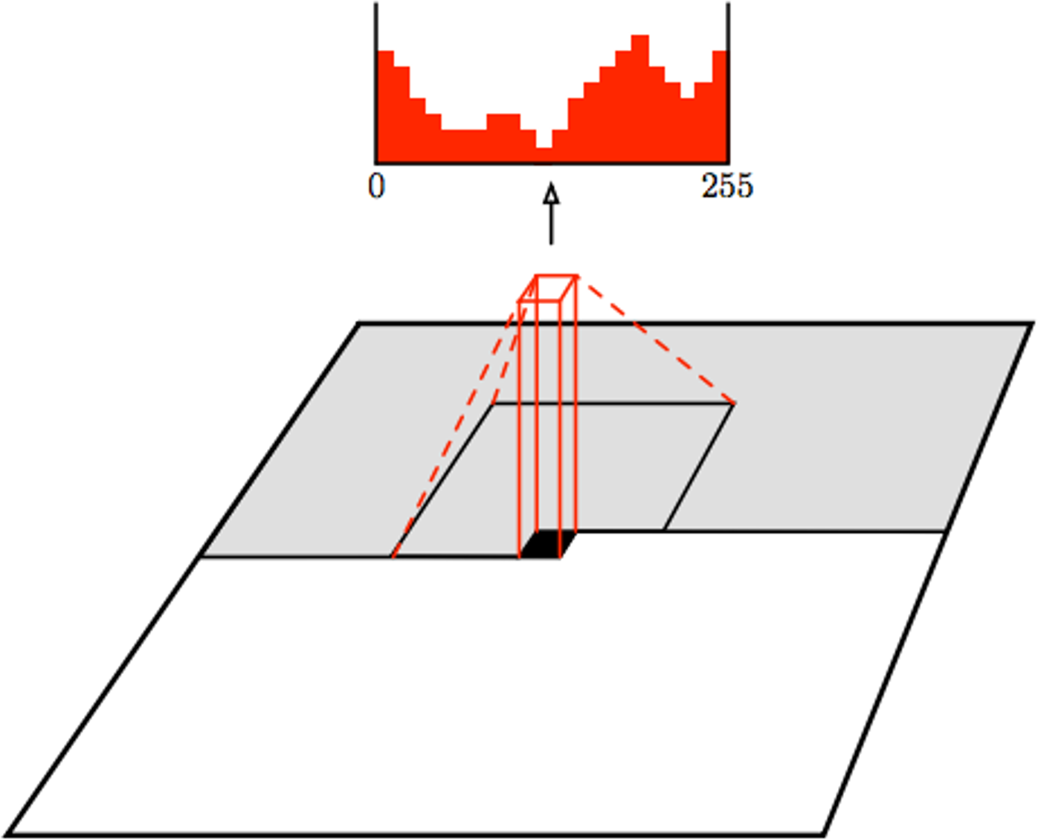
PixelCNN
Still generate image pixels starting from corner
Dependency on previous pixels now modeled using a CNN over context region
Van den Oord et al, “Conditional Image Generation with PixelCNN Decoders”, NeurIPS 2016

Slide 57
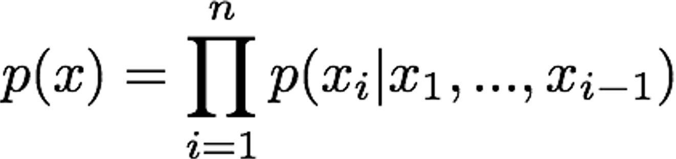
PixelCNN
Softmax loss at each pixel
Still generate image pixels starting from corner
Dependency on previous pixels now modeled using a CNN over context region
Training: maximize likelihood of training images
Van den Oord et al, “Conditional Image Generation with PixelCNN Decoders”, NeurIPS 2016

Slide 58
PixelCNN
Softmax loss at each pixel
Still generate image pixels starting from corner
Dependency on previous pixels now modeled using a CNN over context region
Training: maximize likelihood of training images Training is faster than PixelRNN
(can parallelize convolutions since context region values known from training images)
Generation must still proceed sequentially
=> still slow
Van den Oord et al, “Conditional Image Generation with PixelCNN Decoders”, NeurIPS 2016
Lecture 19 - 58

Slide 59
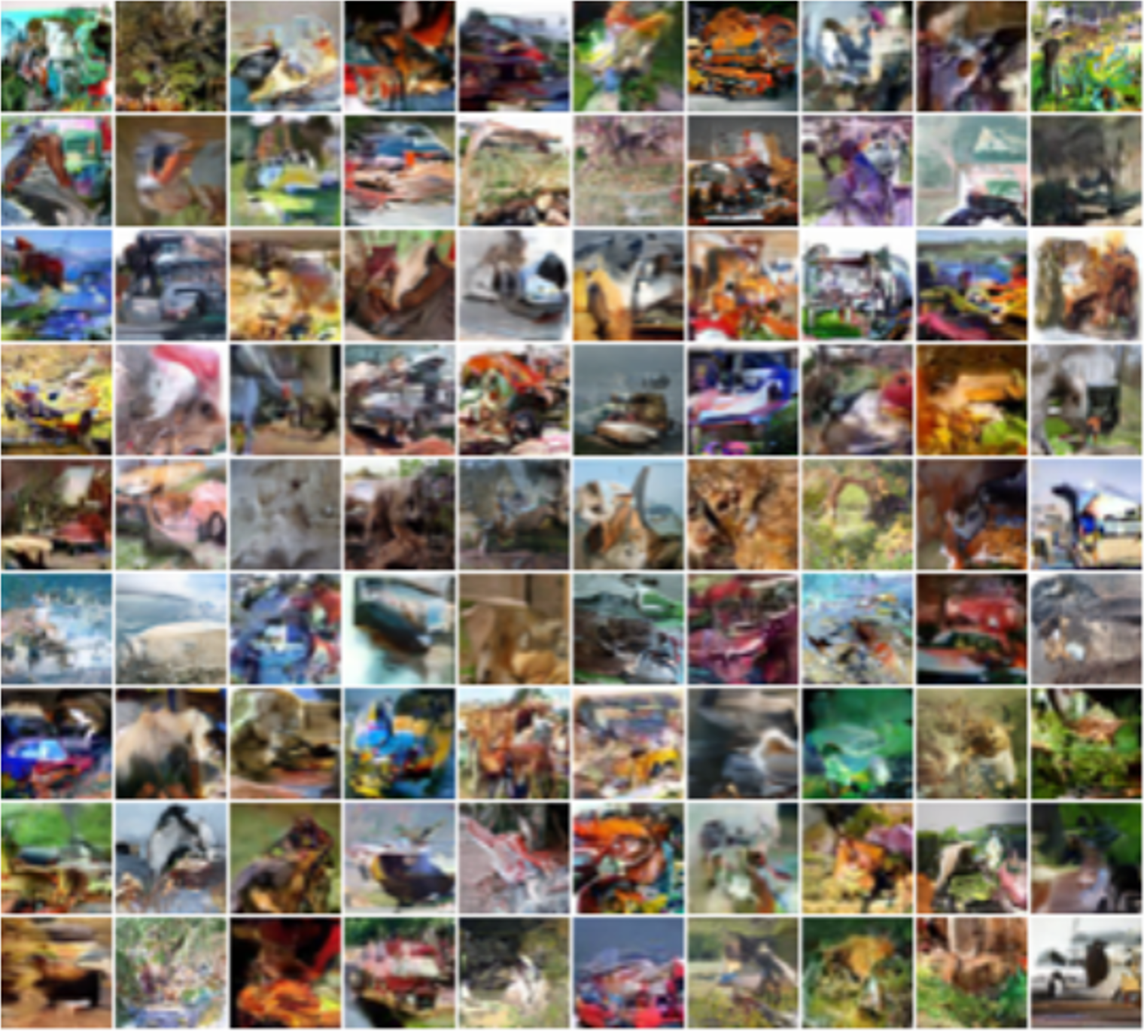
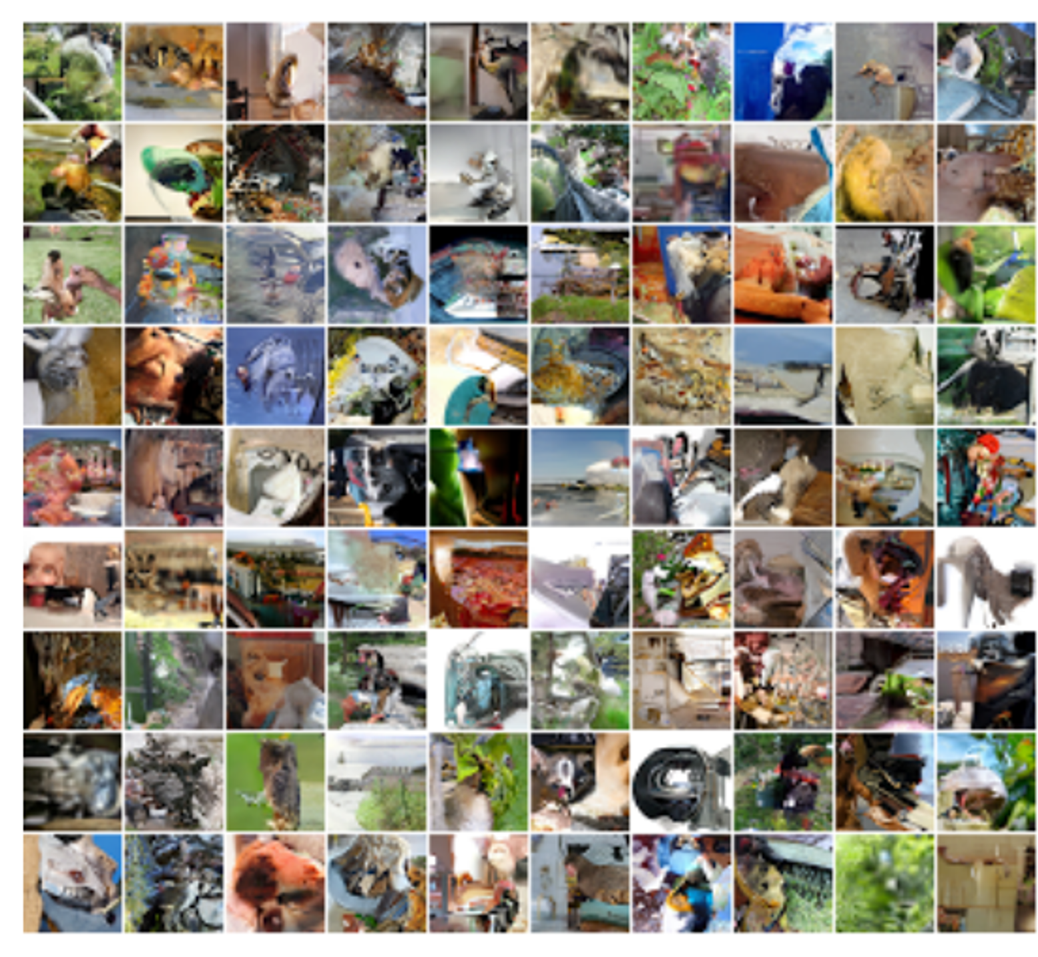
PixelRNN: Generated Samples
32x32 ImageNet
Van den Oord et al, “Pixel Recurrent Neural Networks”, ICML 2016
32x32 CIFAR-10

Slide 60
Autoregressive Models: PixelRNN and PixelCNN
Improving PixelCNN performance
Gated convolutional layers
Short-cut connections
Discretized logistic loss
Multi-scale
Training tricks
Etc…
See
Van der Oord et al. NIPS 2016
Salimans et al. 2017 (PixelCNN++)
Pros:
Can explicitly compute likelihood p(x)
Explicit likelihood of training data gives good evaluation metric
Good samples
Con:
Sequential generation => slow

Slide 61
Variational Autoencoders

Slide 62
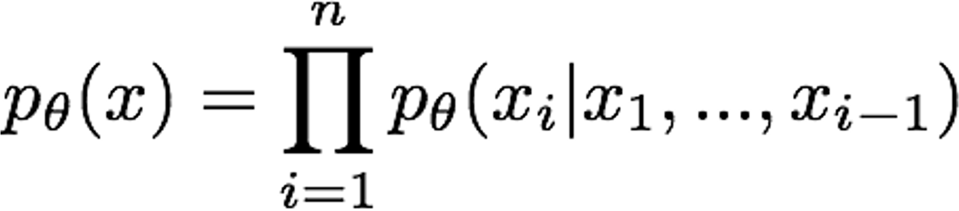
Variational Autoencoders
PixelRNN / PixelCNN explicitly parameterizes density function with a neural network, so we can train to maximize likelihood of training data:
Variational Autoencoders (VAE) define an intractable density that we cannot explicitly compute or optimize
But we will be able to directly optimize a lower bound on the density

Slide 63
Variational Autoencoders

Slide 64
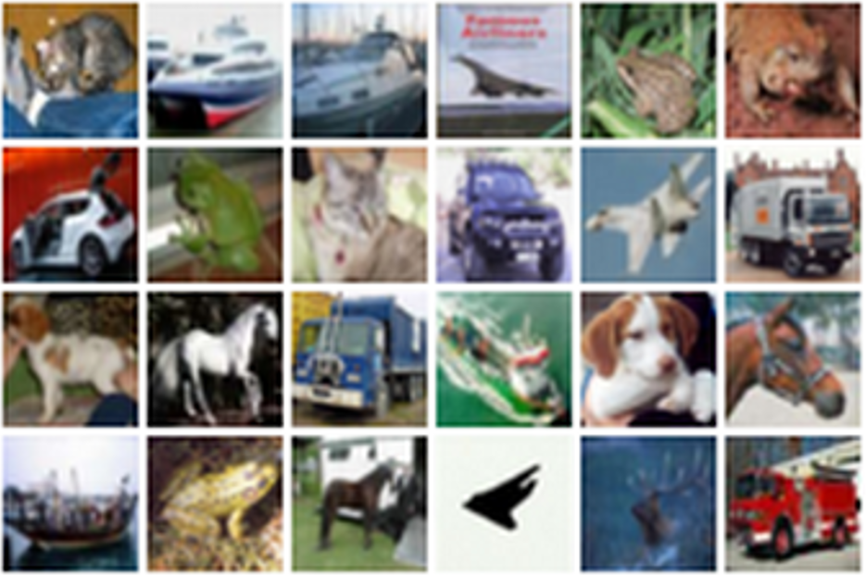
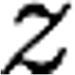
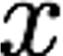
(Regular, non-variational) Autoencoders
Unsupervised method for learning feature vectors from raw data x, without any labels
Features should extract useful information (maybe object identities, properties, scene type, etc) that we can use for downstream tasks
Originally: Linear + nonlinearity (sigmoid)
Later: Deep, fully-connected
Later: ReLU CNN
Features
Encoder
Input data
Input Data
November 11, 2020

Slide 65
(Regular, non-variational) Autoencoders
Problem: How can we learn this feature transform from raw data?
Features should extract useful information (maybe object identities, properties, scene type, etc) that we can use for downstream tasks
But we can’t observe features!
Originally: Linear + nonlinearity (sigmoid)
Later: Deep, fully-connected
Later: ReLU CNN
Features
Encoder
Input data
Input Data
November 11, 2020

Slide 66
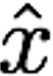
(Regular, non-variational) Autoencoders
Problem: How can we learn this feature transform from raw data? Idea: Use the features to reconstruct the input data with a decoder “Autoencoding” = encoding itself
Originally: Linear +
Reconstructed input data
nonlinearity (sigmoid) Later: Deep, fully-connected Later: ReLU CNN (upconv)
Decoder
Features
Encoder
Input data
Input Data
November 11, 2020

Slide 67
(Regular, non-variational) Autoencoders
Loss: L2 distance between input and reconstructed data.
Loss Function
Does not use any labels! Just raw data!
𝑥' − 𝑥
!
!
Reconstructed input data
Decoder
Features
Encoder
Input data
Input Data
November 11, 2020

Slide 68
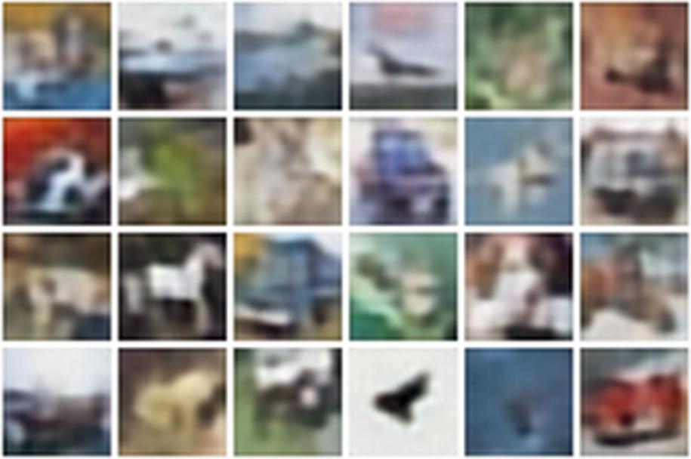
(Regular, non-variational) Autoencoders
Reconstructed data
Loss: L2 distance between input and reconstructed data.
Loss Function
Does not use any labels! Just raw data!
𝑥' − 𝑥
!
!
Decoder:
4 tconv layers
Encoder:
4 conv layers
Reconstructed input data
Decoder
Features
Encoder
Input data
Input Data
November 11, 2020

Slide 69
(Regular, non-variational) Autoencoders
Reconstructed data
Loss: L2 distance between input and reconstructed data.
Loss Function
Does not use any labels! Just raw data!
𝑥' − 𝑥
!
!
Decoder:
4 tconv layers
Encoder:
4 conv layers
Reconstructed input data
Decoder
Features need to be lower dimensional than the data
Features
Encoder
Input data
Input Data
November 11, 2020

Slide 70
(Regular, non-variational) Autoencoders
After training, throw away decoder and use encoder for a downstream task
Reconstructed input data
Decoder
After training, throw away decoder
Features
Encoder
Input data

Slide 71
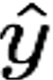
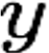
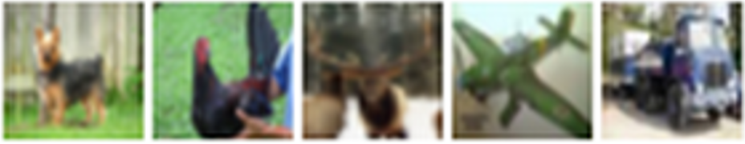
(Regular, non-variational) Autoencoders
After training, throw away decoder and use encoder for a downstream task
Loss function (Softmax, etc)
Encoder can be used to initialize a supervised model
Predicted Label
Fine-tune encoder jointly with classifier
bird plane
Classifier
dog deer
truck
Features
Encoder
Train for final task (sometimes with small data)
Input data
Lecture 19 - 71

Slide 72
(Regular, non-variational) Autoencoders
Autoencoders learn latent features for data without any labels! Can use features to initialize a supervised model
Not probabilistic: No way to sample new data from learned model
Reconstructed input data
Decoder
Features
Encoder
Input data

Slide 73
Variational Autoencoders
Kingma and Welling, Auto-Encoding Variational Beyes, ICLR 2014

Slide 74
Variational Autoencoders
Probabilistic spin on autoencoders:
Learn latent features z from raw data
Sample from the model to generate new data

Slide 75
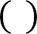
Variational Autoencoders
Probabilistic spin on autoencoders:
Learn latent features z from raw data
Sample from the model to generate new data
Assume training data 𝑥 &
(
is
&'%
generated from unobserved (latent) representation z
Intuition: x is an image, z is latent factors used to generate x: attributes, orientation, etc.

Slide 76
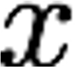
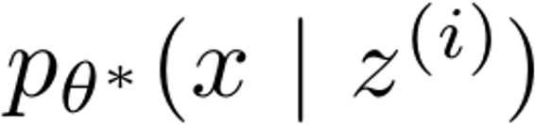
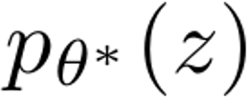
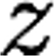
Variational Autoencoders
Probabilistic spin on autoencoders:
Learn latent features z from raw data
Sample from the model to generate new data
Assume training data 𝑥 &
(
is
&'%
generated from unobserved (latent) representation z
Intuition: x is an image, z is latent factors used to generate x: attributes, orientation, etc.
After training, sample new data like this:
Sample from conditional
Sample z from prior

Slide 77
Variational Autoencoders
Probabilistic spin on autoencoders:
Learn latent features z from raw data
Sample from the model to generate new data
After training, sample new data like this:
Sample from conditional
Assume training data 𝑥 &
(
is
&'%
generated from unobserved (latent) representation z
Intuition: x is an image, z is latent factors used to generate x: attributes, orientation, etc.
Assume simple prior p(z), e.g. Gaussian
Sample z from prior

Slide 78
Variational Autoencoders
Probabilistic spin on autoencoders:
Learn latent features z from raw data
Sample from the model to generate new data
After training, sample new data like this:
Assume training data 𝑥 &
(
is
&'%
generated from unobserved (latent) representation z
Intuition: x is an image, z is latent factors used to generate x: attributes, orientation, etc.
Assume simple prior p(z), e.g. Gaussian
Represent p(x|z) with a neural network (Similar to decoder from autencoder)
Sample from conditional
Sample z from prior

Slide 79
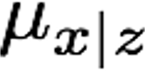
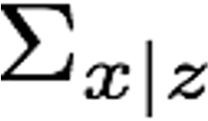
Variational Autoencoders
Decoder must be probabilistic: Decoder inputs z, outputs mean μ_{x|z} and (diagonal) covariance ∑_{x|z}
Sample x from Gaussian with mean μ_{x|z} and (diagonal) covariance ∑_{x|z}
Sample from conditional
Sample z from prior
Assume training data 𝑥 &
(
is
&'%
generated from unobserved (latent) representation z
Intuition: x is an image, z is latent factors used to generate x: attributes, orientation, etc.
Assume simple prior p(z), e.g. Gaussian
Represent p(x|z) with a neural network (Similar to decoder from autencoder)

Slide 80
Variational Autoencoders
Decoder must be probabilistic: Decoder inputs z, outputs mean μ_{x|z} and (diagonal) covariance ∑_{x|z}
Sample x from Gaussian with mean μ_{x|z} and (diagonal) covariance ∑_{x|z}
Sample from conditional
Sample z from prior
Assume training data 𝑥 &
(
is
&'%
generated from unobserved (latent) representation z
How to train this model?
Basic idea: maximize likelihood of data
If we could observe the z for each x, then could train a conditional generative model p(x|z)

Slide 81
Variational Autoencoders
Decoder must be probabilistic: Decoder inputs z, outputs mean μ_{x|z} and (diagonal) covariance ∑_{x|z}
Sample x from Gaussian with mean μ_{x|z} and (diagonal) covariance ∑_{x|z}
Assume training data 𝑥 &
(
is
&'%
generated from unobserved (latent) representation z
How to train this model?
Sample from conditional
Basic idea: maximize likelihood of data
We don’t observe z, so need to marginalize:
= ! 𝑝" 𝑥, 𝑧 𝑑𝑧 = ! 𝑝" 𝑥 𝑧 𝑝" 𝑧 𝑑𝑧
Sample z from prior
𝑝" 𝑥

Slide 82
Variational Autoencoders
Decoder must be probabilistic: Decoder inputs z, outputs mean μ_{x|z} and (diagonal) covariance ∑_{x|z}
Sample x from Gaussian with mean μ_{x|z} and (diagonal) covariance ∑_{x|z}
Assume training data 𝑥 &
(
is
&'%
generated from unobserved (latent) representation z
How to train this model?
Sample from conditional
Basic idea: maximize likelihood of data
We don’t observe z, so need to marginalize:
= ! 𝑝" 𝑥, 𝑧 𝑑𝑧 = ! 𝑝" 𝑥 𝑧 𝑝" 𝑧 𝑑𝑧
Sample z from prior
𝑝" 𝑥
Ok, can compute this with decoder network

Slide 83
Variational Autoencoders
Decoder must be probabilistic: Decoder inputs z, outputs mean μ_{x|z} and (diagonal) covariance ∑_{x|z}
Sample x from Gaussian with mean μ_{x|z} and (diagonal) covariance ∑_{x|z}
Assume training data 𝑥 &
(
is
&'%
generated from unobserved (latent) representation z
How to train this model?
Sample from conditional
Basic idea: maximize likelihood of data
We don’t observe z, so need to marginalize:
Sample z from prior
𝑝" 𝑥
= ! 𝑝" 𝑥, 𝑧 𝑑𝑧 = ! 𝑝" 𝑥 𝑧 𝑝" 𝑧 𝑑𝑧
Ok, we assumed Gaussian prior for z

Slide 84
Variational Autoencoders
Decoder must be probabilistic: Decoder inputs z, outputs mean μ_{x|z} and (diagonal) covariance ∑_{x|z}
Sample x from Gaussian with mean μ_{x|z} and (diagonal) covariance ∑_{x|z}
Assume training data 𝑥 &
(
is
&'%
generated from unobserved (latent) representation z
How to train this model?
Sample from conditional
Basic idea: maximize likelihood of data
We don’t observe z, so need to marginalize:
Sample z from prior
𝑝" 𝑥 = ! 𝑝" 𝑥, 𝑧 𝑑𝑧 = ! 𝑝" 𝑥 𝑧 𝑝" 𝑧 𝑑𝑧
Problem: Impossible to integrate over all z!

Slide 85
Variational Autoencoders
Decoder must be probabilistic: Decoder inputs z, outputs mean μ_{x|z} and (diagonal) covariance ∑_{x|z}
Sample x from Gaussian with mean μ_{x|z} and (diagonal) covariance ∑_{x|z}
Recall 𝑝 𝑥, 𝑧
= 𝑝 𝑥
𝑧 𝑝 𝑧
= 𝑝 𝑧
𝑥 𝑝 𝑥
Assume training data 𝑥 &
(
is
&'%
generated from unobserved (latent) representation z
How to train this model?
Sample from conditional
Basic idea: maximize likelihood of data
Another idea: Try Bayes’ Rule:
₌ 𝑝" 𝑥 𝑧)𝑝" 𝑧
𝑝" 𝑧 𝑥)
Sample z from prior
𝑝 𝑥
"

Slide 86
Variational Autoencoders
Decoder must be probabilistic: Decoder inputs z, outputs mean μ_{x|z} and (diagonal) covariance ∑_{x|z}
Sample x from Gaussian with mean μ_{x|z} and (diagonal) covariance ∑_{x|z}
Recall 𝑝 𝑥, 𝑧
= 𝑝 𝑥
𝑧 𝑝 𝑧
= 𝑝 𝑧
𝑥 𝑝 𝑥
Assume training data 𝑥 &
(
is
&'%
generated from unobserved (latent) representation z
How to train this model?
Sample from conditional
Basic idea: maximize likelihood of data
Another idea: Try Bayes’ Rule:
𝑝" 𝑥 𝑧)
𝑝" 𝑧
𝑝" 𝑧
𝑥)
Sample z from prior
𝑝 𝑥 =
Ok, compute with decoder network
"

Slide 87
Variational Autoencoders
Decoder must be probabilistic: Decoder inputs z, outputs mean μ_{x|z} and (diagonal) covariance ∑_{x|z}
Sample x from Gaussian with mean μ_{x|z} and (diagonal) covariance ∑_{x|z}
Recall 𝑝 𝑥, 𝑧
= 𝑝 𝑥
𝑧 𝑝 𝑧
= 𝑝 𝑧
𝑥 𝑝 𝑥
Assume training data 𝑥 &
(
is
&'%
generated from unobserved (latent) representation z
How to train this model?
Sample from conditional
Basic idea: maximize likelihood of data
Another idea: Try Bayes’ Rule:
₌ 𝑝" 𝑥 𝑧)𝑝" 𝑧
𝑝" 𝑧 𝑥)
Sample z from prior
𝑝 𝑥
Ok, we assumed Gaussian prior
"

Slide 88
Variational Autoencoders
Decoder must be probabilistic: Decoder inputs z, outputs mean μ_{x|z} and (diagonal) covariance ∑_{x|z}
Sample x from Gaussian with mean μ_{x|z} and (diagonal) covariance ∑_{x|z}
Recall 𝑝 𝑥, 𝑧
= 𝑝 𝑥
𝑧 𝑝 𝑧
= 𝑝 𝑧
𝑥 𝑝 𝑥
Assume training data 𝑥 &
(
is
&'%
generated from unobserved (latent) representation z
How to train this model?
Sample from conditional
Basic idea: maximize likelihood of data
Another idea: Try Bayes’ Rule:
₌ 𝑝" 𝑥 𝑧)𝑝" 𝑧
Sample z from prior
𝑝 𝑥
Problem: No way to compute this!
"
𝑝" 𝑧 𝑥)

Slide 89
Variational Autoencoders
Decoder must be probabilistic: Decoder inputs z, outputs mean μ_{x|z} and (diagonal) covariance ∑_{x|z}
Sample x from Gaussian with mean μ_{x|z} and (diagonal) covariance ∑_{x|z}
Recall 𝑝 𝑥, 𝑧
= 𝑝 𝑥
𝑧 𝑝 𝑧
= 𝑝 𝑧
𝑥 𝑝 𝑥
Assume training data 𝑥 &
(
is
&'%
generated from unobserved (latent) representation z
How to train this model?
Sample from conditional
Basic idea: maximize likelihood of data
Another idea: Try Bayes’ Rule:
₌ 𝑝" 𝑥 𝑧)𝑝" 𝑧
𝑝" 𝑧 𝑥)
Solution: Train another network (encoder) that learns
𝑞! 𝑧 𝑥) ≈ 𝑝" 𝑧 𝑥)
Sample z from prior
𝑝 𝑥
"

Slide 90
Variational Autoencoders
Decoder must be probabilistic: Decoder inputs z, outputs mean μ_{x|z} and (diagonal) covariance ∑_{x|z}
Sample x from Gaussian with mean μ_{x|z} and (diagonal) covariance ∑_{x|z}
Recall 𝑝 𝑥, 𝑧
= 𝑝 𝑥
𝑧 𝑝 𝑧
= 𝑝 𝑧
𝑥 𝑝 𝑥
Assume training data 𝑥 &
(
is
&'%
generated from unobserved (latent) representation z
How to train this model?
Sample from conditional
Basic idea: maximize likelihood of data
Another idea: Try Bayes’ Rule:
₌ 𝑝" 𝑥 𝑧)𝑝" 𝑧 ≈ 𝑝" 𝑥 𝑧)𝑝" 𝑧
Sample z from prior
𝑝" 𝑥
𝑝" 𝑧 𝑥) 𝑞# 𝑧 𝑥)
Use encoder to compute 𝑞₎ 𝑧 𝑥) ≈ 𝑝* 𝑧 𝑥)
Lecture 19 - 90

Slide 91
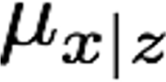
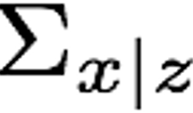
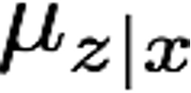
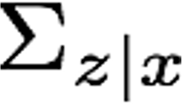
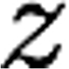

Variational Autoencoders
Decoder network inputs latent code z, gives distribution over data x
𝑝" 𝑥 | 𝑧 = 𝑁(𝜇$|&, Σ$|&)
Encoder network inputs data x, gives distribution over latent codes z
𝑞# 𝑧 | 𝑥 = 𝑁(𝜇&|$, Σ&|$)
If we can ensure that
𝑞# 𝑧 𝑥) ≈ 𝑝" 𝑧 𝑥),
then we can approximate
≈ 𝑝" 𝑥 𝑧)𝑝(𝑧)
𝑝" 𝑥
𝑞# 𝑧 𝑥)
Idea: Jointly train both encoder and decoder
Lecture 19 - 91

Slide 92
Variational Autoencoders
𝑝₍ 𝑥 𝑧)𝑝(𝑧)
𝑝₍ 𝑧 𝑥)
log 𝑝 (𝑥) = log
(
Bayes’ Rule
Lecture 19 - 92

Slide 93
Variational Autoencoders
𝑝₍ 𝑥
𝑧)𝑝(𝑧) _{= log} 𝑝₍ 𝑥 𝑧 𝑝 𝑧 𝑞₎(𝑧|𝑥)
log 𝑝 (𝑥) = log
(
𝑝₍ 𝑧 𝑥) 𝑝₍ 𝑧 𝑥 𝑞₎(𝑧|𝑥)
Multiply top and bottom by q_{Φ}(z|x)
Lecture 19 - 93

Slide 94
Variational Autoencoders
𝑝₍ 𝑥
𝑧)𝑝(𝑧) _{= log} 𝑝₍ 𝑥 𝑧 𝑝 𝑧 𝑞₎(𝑧|𝑥)
log 𝑝 (𝑥) = log
(
𝑝₍ 𝑧 𝑥) 𝑝₍ 𝑧 𝑥 𝑞₎(𝑧|𝑥)
𝑞₎ 𝑧|𝑥 𝑞₎(𝑧|𝑥)
𝑥 𝑧 − log _{𝑝(𝑧)} + log _{𝑝((𝑧|𝑥)}
= log 𝑝
(
Split up using rules for logarithms
Lecture 19 - 94

Slide 95
Variational Autoencoders
𝑝₍ 𝑥 𝑧)𝑝(𝑧) _{= log}
𝑝₍ 𝑧 𝑥)
𝑝₍ | 𝑥 | 𝑧 | 𝑝 | 𝑧 | 𝑞₎(𝑧^{c} |𝑥)
log 𝑝 (𝑥) = log
(
𝑝₍ 𝑧 𝑥 𝑞₎(𝑧^{c} |𝑥)
𝑞₎ 𝑧|𝑥
𝑞₎(c𝑧|𝑥)
+ log
= log
𝑝₍ 𝑥 𝑧
− log
𝑝(𝑧) 𝑝₍(𝑧|𝑥)
Split up using rules for logarithms
Lecture 19 - 95

Slide 96
Variational Autoencoders
𝑝₍ 𝑥
𝑧)𝑝(𝑧) _{= log} 𝑝₍ 𝑥 𝑧 𝑝 𝑧 𝑞₎(𝑧|𝑥)
log 𝑝 (𝑥) = log
(
𝑝₍ 𝑧 𝑥) 𝑝₍ 𝑧 𝑥 𝑞₎(𝑧|𝑥)
𝑞₎ 𝑧|𝑥 𝑞₎(𝑧|𝑥)
𝑥 𝑧 − log _{𝑝(𝑧)} + log _{𝑝((𝑧|𝑥)}
= log 𝑝
(
We can wrap in an expectation since it doesn’t depend on z
log 𝑝₍ 𝑥
= 𝐸_{*~,'(*|/)} log 𝑝₍(𝑥)
Lecture 19 - 96

Slide 97
Variational Autoencoders
𝑝₍ 𝑥
𝑧)𝑝(𝑧) _{= log} 𝑝₍ 𝑥 𝑧 𝑝 𝑧 𝑞₎(𝑧|𝑥)
log 𝑝 (𝑥) = log
(
𝑝₍ 𝑧 𝑥) 𝑝₍ 𝑧 𝑥 𝑞₎(𝑧|𝑥)
𝑞₎ 𝑧 𝑥
log
𝑞₎(𝑧|𝑥)
+ 𝐸 log
= 𝐸*[log 𝑝₍(𝑥|𝑧)] − 𝐸*
𝑝 𝑧
*
𝑝₍(𝑧|𝑥)
We can wrap in an expectation since it doesn’t depend on z
log 𝑝₍ 𝑥
= 𝐸_{*~,'(*|/)} log 𝑝₍(𝑥)
Lecture 19 - 97

Slide 98
Variational Autoencoders
𝑝₍ 𝑥
𝑧)𝑝(𝑧) _{= log} 𝑝₍ 𝑥 𝑧 𝑝 𝑧 𝑞₎(𝑧|𝑥)
log 𝑝 (𝑥) = log
(
𝑝₍ 𝑧 𝑥) 𝑝₍ 𝑧 𝑥 𝑞₎(𝑧|𝑥)
𝑞₎ 𝑧 𝑥 log _{𝑝 𝑧}
𝑞₎(𝑧|𝑥)
+ 𝐸 log
= 𝐸*[log 𝑝₍(𝑥|𝑧)] − 𝐸*
*
𝑝₍(𝑧|𝑥)
= 𝐸_{(~*+((|-)}[log 𝑝.(𝑥|𝑧)] − 𝐷_{/0}
Data reconstruction
𝑞₁ 𝑧 𝑥 , 𝑝 𝑧
+ 𝐷_{/0}(𝑞₁ 𝑧 𝑥 , 𝑝. 𝑧 𝑥 )
Lecture 19 - 98

Slide 99
Variational Autoencoders
𝑝₍ 𝑥
𝑧)𝑝(𝑧) _{= log} 𝑝₍ 𝑥 𝑧 𝑝 𝑧 𝑞₎(𝑧|𝑥)
log 𝑝 (𝑥) = log
(
𝑝₍ 𝑧 𝑥) 𝑝₍ 𝑧 𝑥 𝑞₎(𝑧|𝑥)
𝑞₎ 𝑧 𝑥 log _{𝑝 𝑧}
𝑞₎(𝑧|𝑥)
+ 𝐸 log
= 𝐸*[log 𝑝₍(𝑥|𝑧)] − 𝐸*
*
𝑝₍(𝑧|𝑥)
= 𝐸_{(~*+((|-)}[log 𝑝.(𝑥|𝑧)] − 𝐷_{/0} 𝑞₁ 𝑧 𝑥 , 𝑝 𝑧 + 𝐷_{/0}(𝑞₁ 𝑧 𝑥 , 𝑝. 𝑧 𝑥 )
KL divergence between prior, and samples from the encoder network
Lecture 19 - 99

Slide 100
Variational Autoencoders
𝑝₍ 𝑥
𝑧)𝑝(𝑧) _{= log} 𝑝₍ 𝑥 𝑧 𝑝 𝑧 𝑞₎(𝑧|𝑥)
log 𝑝 (𝑥) = log
(
𝑝₍ 𝑧 𝑥) 𝑝₍ 𝑧 𝑥 𝑞₎(𝑧|𝑥)
𝑞₎ 𝑧 𝑥 log _{𝑝 𝑧}
𝑞₎(𝑧|𝑥)
+ 𝐸 log
= 𝐸*[log 𝑝₍(𝑥|𝑧)] − 𝐸*
*
𝑝₍(𝑧|𝑥)
𝑞₁ 𝑧 𝑥 , 𝑝 𝑧 + 𝐷_{/0}(𝑞₁ 𝑧 𝑥 , 𝑝. 𝑧 𝑥 )
KL divergence between encoder and posterior of decoder
= 𝐸_{(~*+((|-)}[log 𝑝.(𝑥|𝑧)] − 𝐷_{/0}
Lecture 19 - 100

Slide 101
Variational Autoencoders
𝑝₍ 𝑥
𝑧)𝑝(𝑧) _{= log} 𝑝₍ 𝑥 𝑧 𝑝 𝑧 𝑞₎(𝑧|𝑥)
log 𝑝 (𝑥) = log
(
𝑝₍ 𝑧 𝑥) 𝑝₍ 𝑧 𝑥 𝑞₎(𝑧|𝑥)
𝑞₎ 𝑧 𝑥 log _{𝑝 𝑧}
𝑞₎(𝑧|𝑥)
+ 𝐸 log
= 𝐸*[log 𝑝₍(𝑥|𝑧)] − 𝐸*
*
𝑝₍(𝑧|𝑥)
𝑞₁ 𝑧 𝑥 , 𝑝 𝑧 + 𝐷_{/0}(𝑞₁ 𝑧 𝑥 , 𝑝. 𝑧 𝑥 )
KL is >= 0, so dropping this term gives a
lower bound on the data likelihood:
= 𝐸_{(~*+((|-)}[log 𝑝.(𝑥|𝑧)] − 𝐷_{/0}
Lecture 19 - 101

Slide 102
Variational Autoencoders
𝑝₍ 𝑥
𝑧)𝑝(𝑧) _{= log} 𝑝₍ 𝑥 𝑧 𝑝 𝑧 𝑞₎(𝑧|𝑥)
log 𝑝 (𝑥) = log
(
𝑝₍ 𝑧 𝑥) 𝑝₍ 𝑧 𝑥 𝑞₎(𝑧|𝑥)
𝑞₎ 𝑧 𝑥 log _{𝑝 𝑧}
𝑞₎(𝑧|𝑥)
+ 𝐸 log
= 𝐸*[log 𝑝₍(𝑥|𝑧)] − 𝐸*
*
𝑝₍(𝑧|𝑥)
= 𝐸_{(~*+((|-)}[log 𝑝.(𝑥|𝑧)] − 𝐷_{/0} 𝑞₁ 𝑧 𝑥 , 𝑝 𝑧
+ 𝐷_{/0}(𝑞₁ 𝑧 𝑥 , 𝑝. 𝑧 𝑥 )
log 𝑝₊ 𝑥 ≥ 𝐸_{,~.!(,|0)}[log 𝑝₊(𝑥|𝑧)] − 𝐷₁₂ 𝑞₃ 𝑧 𝑥 , 𝑝 𝑧
Lecture 19 - 102

Slide 103






Variational Autoencoders
Jointly train encoder q and decoder p to maximize the variational lower bound on the data likelihood
log 𝑝₊ 𝑥 ≥ 𝐸_{,~.!(,|0)}[log 𝑝₊(𝑥|𝑧)] − 𝐷₁₂ 𝑞₃ 𝑧 𝑥 , 𝑝 𝑧
Encoder Network Decoder Network
𝑞# 𝑧 | 𝑥 = 𝑁(𝜇&|$, Σ&|$) 𝑝" 𝑥 | 𝑧 = 𝑁(𝜇$|&, Σ$|&)
Lecture 19 - 103

Slide 104
Next Time: Generative Models, part 2
More Variational Autoencoders, Generative Adversarial Networks
Lecture 19 - 104

